Slide 1
PROJECT MASTER PRESENTATION
EcoWise AI Platform
Agentic AI for multimodal campus waste classification, 12ms edge telemetry, and IBM Granite RAG decision governance.
CORE PILLARS:
NIR Vision Sorting
•
FastAPI Engine
•
IBM Granite 3.0 RAG
•
HITL Governance
By-
Harsh Kumar Jha

Slide 2



EXECUTIVE SUMMARY
Autonomous Campus Intelligence
Multimodal Sorting
12ms Mesh Telemetry
Granite RAG Audit
Real-time optical object classification.
Edge vibration and energy monitoring.
Grounded citations for ISO 14001.

Slide 3
PROBLEM CONTEXT
Campus Operational Bottlenecks
Traditional Campus Limitations
EcoWise Autonomous Solution
>35% Contamination: High sorting error rates
<0.5% Contamination: Precision pneumatic routing
Zero Telemetry: Invisible power surges
12ms Live Stream: Mesh sensor tracking
Delayed Feedback: Waste spikes undetected for days
Instant Alerting: Autonomous anomaly triggering
Manual Audits: Subjective compliance logging
Granite RAG: Verifiable compliance grounding

Slide 4
SUSTAINABILITY COMMITMENT
UN SDG Alignment
SDG 12
SDG 11
SDG 13
SDG 4
Responsible Consumption
Sustainable Cities
Climate Action
Quality Education
Eliminating campus bin contamination.
22% conveyor energy reduction.
Student eco-impact engagement.
98.7% material purity recovery.

Slide 5

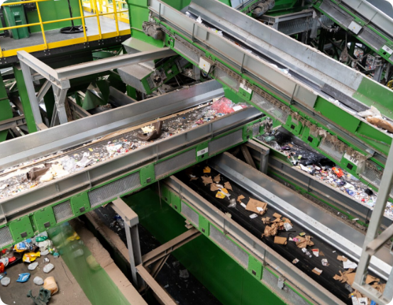
SYSTEM ARCHITECTURE
Decoupled Microservices Pipeline
React 18 & Vite 5 UI
Tailwind chassis with live SVG gauges.
FastAPI Async Engine
Pydantic validation with SQLAlchemy ORM.
IBM Granite 3.0 Core
Deterministic compliance knowledge grounding.

Slide 6
UI ARCHITECTURE
Frontend Client Stack
Component Foundation
Styling & Motion
Analytics & Network
React 18: Strict mode concurrence
Tailwind CSS: Dark chassis system
Recharts Engine: Area, bar, and donuts
TypeScript: Complete schema safety
Lucide Suite: Vector industrial icons
Axios Client: Bearer auth injection
Vite 5: Sub-second module reload
Fallbacks: Resilient mock stores
SVG Gauges: Real-time dynamic strokes

Slide 7
BACKEND SERVICES
FastAPI High-Throughput Engine
Python 3.10+ Async
SQLAlchemy ORM
Pydantic V2 Schemas
Concurrent event loops for telemetry.
SQLite and PostgreSQL persistence.
Strict runtime payload validation.

Slide 8


VIEWPORT 1: /LOGIN
Dual-Role Security Authentication
Operator / Admin Role
Student / Campus Role
Account: operator@ecowise.ai (admin123)
Account: student@ecowise.ai (student123)
Sensor Control: Dynamic slider calibration
Impact Tracking: Building sustainability index
HITL Authority: Approve or modify proposals
Scanner Demo: Item classification testing
Exports: Full structured CSV and PDF logs
Knowledge Base: Granite RAG compliance queries

Slide 9
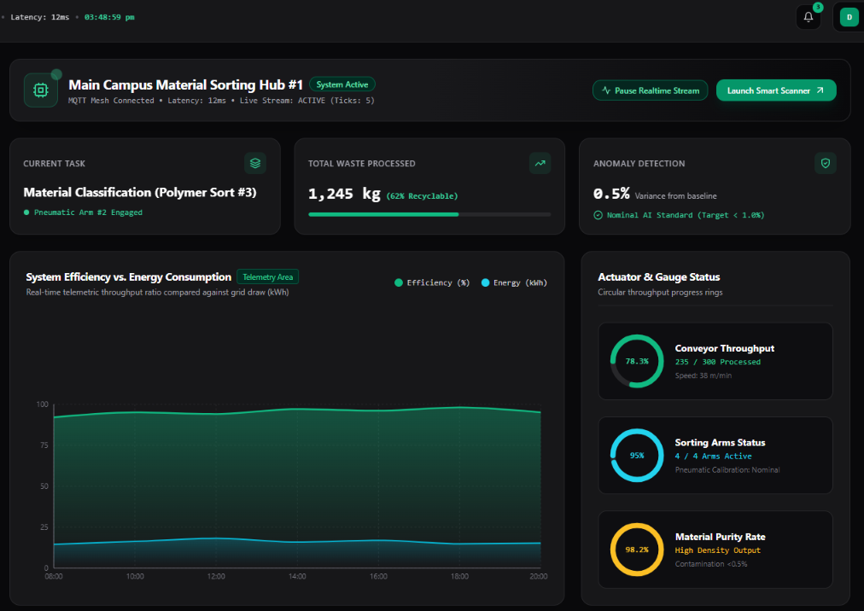

VIEWPORT 2: /DASHBOARD
Central Operations Cockpit
Recharts Area Stream
Efficiency percentage vs energy draw.
12ms Mesh Telemetry
Continuous edge sensor communication.
Active KPI Badges
1,245 kg tracked with 0.5% variance.

Slide 10
HARDWARE TELEMETRY
SVG Radial Telemetry Gauges
76.6%
95.0%
98.2%
Line Throughput
Actuator Status
Material Purity
230 of 300 items processed.
Pneumatic arms fully calibrated.
High-grade recovered stream.

Slide 11
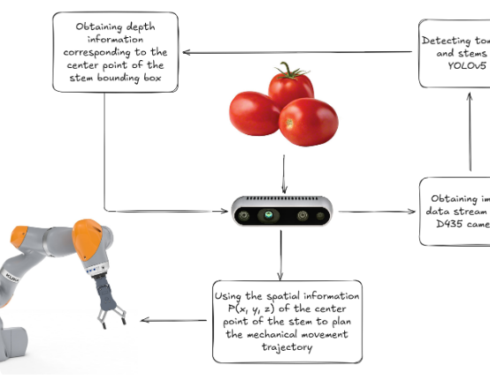
VIEWPORT 3: /SCANNER
Multimodal Waste Classification
Bounding Box Inference
PET Plastic 94% and Can 98%.
Dynamic Confidence Tuning
0-100% threshold calibration sliders.
Conveyor Speed Modulation
10-100 m/min adaptive rate control.

Slide 12



DIAGNOSTICS PANEL
Oscillation & Live Terminal
Motor Oscillation
Power Telemetry
Terminal Stream
Continuous vibration in mm/s.
Active conveyor watt consumption.
Timestamped actuator events.

Slide 13


VIEWPORT 7: /KB
IBM Granite 3.0 RAG Engine
Ungrounded AI Risk
Granite Grounded RAG
Hallucinations: Fabricated disposal rules
Ref #GR-883: ISO 14001:2024 compliance
Audit Lag: Zero verifiable citations
EPA Guidance: Deterministic circular rules
Penalties: Risk of regulatory fines
Direct Chute: Policy-driven diversion

Slide 14
VIEWPORT 4: /ANALYTICS
Campus Resource Intelligence
5 Campus Blocks
Stream Purity
Audit Export
Building power and water metrics.
Plastics 98.7% and metals 99.1% pure.
Structured CSV and PDF reporting.

Slide 15
DECISION SUPPORT
EcoAction HITL Workflow
1
2
3
4
Surge Detection
RCA Analysis
Plan Creation
Human Action
32.9% plastic anomaly flagged.
Granite isolates cafeteria load.
6.2 bar actuator calibration.
1-click approval or modification.

Slide 16
VIEWPORT 5: /SENSORS
IoT Mesh & Pneumatics
12 Edge Nodes
Pneumatic Valves
Node Health
Active MQTT telemetry mesh grid.
Piston pressure and cycle logging.
Battery voltage and ping latency.

Slide 17

VIEWPORT 6: /AGENT
Agentic Policy Governance
Human-in-the-Loop Mode
Full Autonomous Mode
Operator Veto: Plan requires 1-click authorization
Sub-Second Trigger: Immediate valve actuation
Parameter Tuning: Live modal pressure adjustments
Automated Throttle: Real-time conveyor slowdown
Audit Trail: Explicit operator signatures stored
Granite Direct Execution: Rule-based actions
Safety Gate: Essential for hazardous waste
Peak Efficiency: Maximizes line sorting speed

Slide 18
PERFORMANCE BENCHMARKS
Platform Operational Impact
98.7%
<0.5%
-22%
300
Stream Purity Rate
Residual Contamination
Conveyor Energy Draw
Items / Hr Capacity

Slide 19
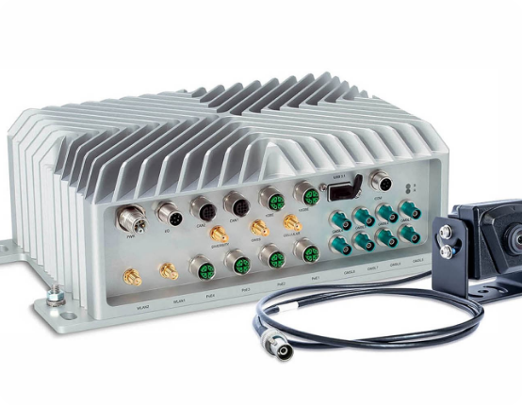
ENGINEERING ROADMAP
Future Scope & Edge Hardware
Jetson Nano Edge AI
Direct neural camera inference.
LSTM Predictive Health
Forecasting actuator vibration failure.
Blockchain Ledger
Immutable campus recycling audit trail.

Slide 20
Thank You
EcoWise AI: Transforming campus waste streams into circular resource intelligence.
• Autonomous Sorting
•
• Real-Time Telemetry
•
• Granite RAG Governance

